Slide 1
Dear Member, Thank you
Notes:
YOU are Outstanding as always!
Thank you for renewing your dues.
Thank you for volunteering your time.
Thank you participating in so many activities and events that support the children at Mooseheart and the seniors at Moosehaven.
AND thank you for donating to Moose Charities!

Slide 2
Notes:
The Mooseheart Activity Center project began in 2019.
The plan.
To build an activity center that will provide for children
at Mooseheart the kind of social activities that are difficult to measure and yet more important than ever.

Slide 3
January 2022 Mooseheart Activity Center (MAC)
Notes:
Our Association’s goal was _______________________we have raised $_______________________
Imagine an after school activity or maybe a siblings day held in this new building!
YOU made this happen.
The ribbon cutting is scheduled for the weekend in June when we celebrate the Mooseheart Graduation and the 2022 Pilgrim conferral.
Please stop in at the Moose Charities office on that Friday for a visit.

Slide 4
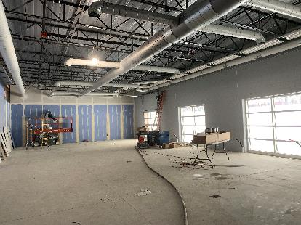
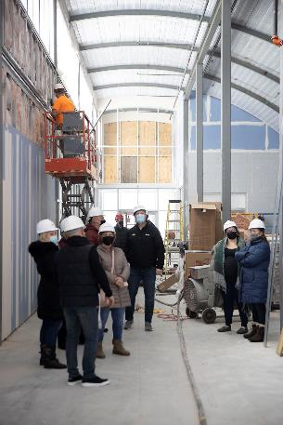
The MAC – In progress
Common area for gaming, foosball, pool table, etc.
4-Lane Bowling Alley
Children’s play area & climbing wall.
Windows look out to splash pad.
Notes:
Here’s a glimpse of work in progress inside of the MAC. It’s coming along and soon enough, our Mooseheart children will be enjoying everything it will have to offer.

Slide 5
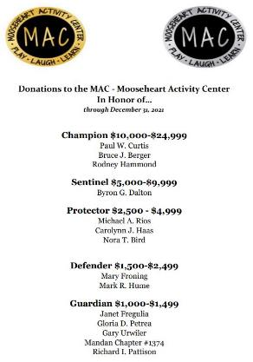
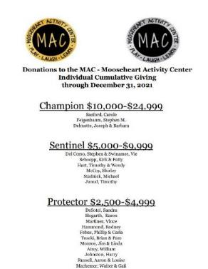
Thanks…from the Heart!
Donors for the MAC are recognized on the Moose Charities website
See the lists at www.moosecharities.org
Notes:
Be sure to go to the Moose Charities website to view the lists of donors who are helping to make this project possible.
Lists can be found on the Recognition page.

Slide 6
February Rocker Fundraiser
Notes:
I would like to share some great news from Moose Charities.
February marks the annual Rocker Fundraiser held at your lodge. Thank you for your donations.
Our association raised $____________in February 2021
(if available after March 2022 report on the February 2022 totals)
This fundraiser supports the endowment fund and your lodge receives the credit for the annual giving.

Slide 7
MOOSEHEART BOYS . . . SMILE!

Slide 8
League of Guardians Dinner 2021
Notes:
Check your calendars. The Moose Year ends on April 30th and those households who have given $1,000 or more to Moose Charities for any projects or programs during a fiscal year are recognized with an exclusive dinner held at the Moose Intl. Convention in Orlando this year.
(this is an opportunity to recognize League of Guardian members from your Moose Association)

Slide 10
MOOSEHAVEN COUPLE . . . MORE SMILES!

Slide 11
CAMP ROSS….KEEP SMILING!

Slide 12
Notes:
Raise your hand if you have participated in the Moose Charities Sweepstakes.
We send out two sweepstakes mailings per year. To ensure you are on the list, make a donation directly to Moose Charities. All other member addresses are chosen randomly from the membership database. The winners are notified and listed on the Moose Charities Website.
This is a very successful fundraiser for us and we hope you watch for the next mailing at the end of April 2022

Slide 13
Holiday Lights 5k
Notes:
6th Annual Holiday Lights 5k Run/Walk, November 20, 2021
This year’s event took place in-person at Mooseheart on Nov. 20, and virtually throughout November.
Thank you for participating from near and far.
Moose Charities raised $62,641.43 for Mooseheart

Slide 14
Note to Santa:
____I’ve been very good this year
____I tried to be good this year
__X__Never mind I will buy my own presents
Notes:
Many of us use Amazon to do our shopping.
Some of you use the amazon app on your phone
Amazon shoppers,
If you have connected your Amazon account to AmazonSmile and have chosen either Mooseheart or Moosehaven as your charity of choice, we have good news for you.
Total Raised from Amazon is ….drum roll please… $9,143.05 this fiscal year through January 2022!!!
Keep up the shopping!
If you haven’t selected Mooseheart or Moosehaven as your Amazon charity of choice yet, please make that your new year’s resolution to update your account as soon as possible.

Slide 15
Thank you!!
Notes:
And Finally THANK YOU THANK YOU THANK YOU
Please see me or someone from the Moose Charities committee to find out more.

