Slide 1



The Future
of Fraternal Recognition

Slide 2

Fraternal Recognition Committee
Purpose:
Develop a
process for future
recognition programs
of The Moose
Notes:
Do we want to target non-degree holders and/or younger members? Do we keep our legacy degrees for
those who have already earned degrees and those who are on the path to earning higher
degrees? Do we focus on something totally new? We need direction on which path to take and
that will likely take some time. similar to the Stand As One
Committee, will be very important to the future of the Moose. Scott mentioned that the Stand As
One Committee considered possibly making changes to honors, higher degrees and recognitions
as part of One Moose implementation, but decided not to due to potential pushback from current
higher degree members. We are now two years past One Moose implementation and it is time to
tackle needed changes to current recognition programs. acknowledged that
recognition isn’t the primary motivation for most traditional Moose members contributing their time
and effort, however, higher degrees and honors are valued by members. The younger generation
is different in that timely recognition and rewards are a top priority for them. All signs indicate that
the Moose membership is ready for a change, and developing and implementing that change is
the challenge for this Committee. We don’t know what the timeline will be but it will likely lead to a
Town Hall meeting similar to One Moose.

Slide 3

Fraternal Recognition Committee Members
Scott Hart
Barb McPherson
Brian Toseki, Chairman
Mark Penzkover, Secretary
Sandy Johnston
Cathy Funkey
Karyn Johnson
Terry Walls
Mike Rios
Shawn Baile
Denielle Baile
FRC@mooseintl.org

Slide 4


Current
Degree
Structure
years

Slide 5


Current Degree Structure
Women of the Moose

Slide 6

Academy of Friendship
Chapter shall earn the Award of Achievement
If serving as an officer or committee chairman:
If installed on or before January 31st, she must sponsor at least 1 Chapter member between May 1st and April 30th; applicant must be enrolled by April 30th.
If installed after January 31st, she must sponsor at least 3 Chapter members between May 1st & April 30th; applicants must be enrolled by April 30th.
  If serving as a Committee Chairman, she must hold a fundraising project and remit minimum donations to Moose Charities via Form 114.
If not serving in an installed position: “Five for Friendship”
  Sponsor 5 Chapter members between May 1st & April 30th; applicants must be enrolled by April 30th.
  Conferred at Association Midyear Conference
GL
96
Notes:
The chapter shall qualify for the Award of
Achievement.
2. A member serving as an elected or appointed officer
or Chapter Committee Chairman shall be elected and
installed on or before January 31, shall serve through
the end of the chapter year April 30 and shall sponsor
and enroll one (1) or more new or re-enrolled
members into the Chapter between May 1 and April
30. If installed after January 31, she must sponsor
and enroll three (3) or more new or re-enrolled
members into the Chapter as well as fulfill her
obligations under number 3.
3. The Chapter Committee Chairman shall hold a
fundraising project to cover the expenses of the
committee which may include: a recommended
twenty dollars ($20.00) or more donation to the
Women of the Moose Scholarship and Maintenance
Fund and a recommended thirty dollars ($30.00) or
more donation to the special project of their
committee that shall benefit Mooseheart or
Moosehaven; to help defray expenses of meeting
night; and help maintain the General Fund of the
chapter.
4. Any member not installed into a position may earn
her Academy of Friendship degree by sponsoring and
enrolling five (5) or more new or re-enrolled members
into the Chapter between May 1 and April 30.

Slide 7

Star
Chapter shall earn the Award of Achievement
Member shall be elected and installed as Chapter Treasurer on or before July 31st and serves through April 30th.
Attend Chapter meetings regularly.
Chapter Treasurer shall sponsor 2 Chapter members between May 1st & April 30th; applicants must be enrolled by April 30th.
Chapter financial records must be reconciled in QuickBooks by the 15th of each month.
Treasurer shall attend WOTM Training and 2-HOTT training during her term of office.
Maintain accurate and timely membership and financial records.
For US Chapters - File the IRS 990 by Sept. 15th.
Conferred at the International Convention
GL 103
Notes:
1. The chapter shall earn the Award of Achievement.
2. The member shall be elected and installed as
Treasurer on or before July 31 and shall serve in this
capacity through April 30.
3. The Treasurer shall sponsor and enroll two (2) or
more new or re-enrolled members into the Chapter
between May 1 and April 30.
4. The chapter financial accounts shall be reconciled by
the 15th day of each month.
5. The Treasurer shall sort the active membership into
the three (3) Chapter Committees and provide the
lists to the Senior Regent.
74
6. She shall attend Board of Officer’s meetings, and
monthly Chapter meetings as required under Section
45.
7. She shall attend Moose sponsored/endorsed
computer training as required by the Grand Council.
8. She shall attend the Annual Women of the Moose
Training Session.
9. All Tax and Government Reports, including the Form
990-Exempt Organization and Form 944 shall be
filed and paid on time, when applicable.
10. All receipts and expenditures are recorded accurately
and properly balanced.
11. All applications shall be transmitted to Moose
International as appropriate.
12. Membership records, reports and files shall be kept
current. Membership updates and status changes
shall be reported weekly. Committee Meeting and
fundraising information shall be reported to Women
of the Moose Headquarters as required.
If the Treasurer does not fulfill the above qualifications, or if
it is determined that any records have been falsified, or that
the Financial Review Committee did not verify the monthly
financial reports, the Star Degree shall not be awarded or the
degree may be revoked, or removed as appropriate at the sole
discretion of Women of the Moose Headquarters. This action
is to be taken only after verification is done by investigation.

Slide 8


Golden Gavel
Chapter shall earn the Award of Achievement
Member shall be installed as Senior Regent on or before July 31st and serve through April 30th.
Attend Chapter meetings regularly.
Shall appoint a Guide and all Chapter Committee Chairmen, all of whom must be properly installed.
Shall sponsor 2 Chapter members between May 1st & April 30th; applicants must be enrolled by April 30th.
Shall assign Chapter Committees.
Assure Forms 114 and 166 are remitted timely, along with minimum donations.
Shall attend WOTM Training during her term of office.
GL 97-98
  Conferred upon qualified JPR at Association Annual Convention
Notes:
Eligibility for the Golden Gavel honor shall be limited to a
member who served a full term as Senior Regent. While
serving as Senior Regent the following requirements shall be
met:
1. The chapter shall earn the Award of Achievement.
2. The Senior Regent shall be elected and installed on or
before July 31 and serve in the same capacity through the
end of the chapter year, April 30.
3. The Senior Regent shall, on or before January 31, appoint
and have installed all Chapter Committee Chairmen and
Guide. In the event the chapter does not have a qualified
higher degree member to serve as the Higher Degree
Chairman, the Senior Regent will receive credit towards
qualifying for individual honors.
4. If, at any time during the chapter year, a vacancy should
occur in any of the above positions, the Senior Regent
shall immediately appoint another member to fill the
position and the member shall be properly installed by a
Collegian.
5. The Senior Regent shall, between May 1 and April 30,
sponsor and enroll two (2) or more new or re-enrolled
members into the Chapter.
6. The Senior Regent shall remit all Forms 114 and 166
completed in their entirety, by their respective deadlines
as well as any other forms as requested to Women of the
Moose headquarters during her term of office as Senior
Regent. All reports shall be received at Women of the
Moose headquarters as instructed on the report to be
eligible for the Golden Gavel. THERE SHALL BE NO
EXCEPTIONS. Please see the list of required forms/
reports in the Officers’ handbook.
68
7. The Senior Regent shall notify every member on the
chapter rolls of the Chapter Committee to which she has
been appointed.
8. The Senior Regent shall attend the Annual Women of the
Moose Training Session.
9. The Senior Regent shall attend Board of Officer’s
meetings, and monthly Chapter meetings as required.
Section 98. GOLDEN GAVEL.
1. After the records for the chapter year are checked, a
member who met the requirements as outlined in Section
97 while serving as Senior Regent, may be presented with
the Golden Gavel at the annual State/Provincial
Convocation.
2. The Golden Gavel shall signify the member is eligible to
meet the requirements for the College of Regents degree
while serving as Junior Past Regent.

Slide 9

College of Regents
Chapter shall earn the Award of Achievement
**Limited to member who has met qualifications during her terms as Senior Regent & Junior Past Regent.**
Member shall be installed as Junior Past Regent on or before July 31st and serve through April 30th.
Attend Chapter meetings regularly.
JPR shall sponsor 2 Chapter members between May 1st & April 30th; applicants must be enrolled by April 30th.
JPR serves as Chairman of the Golden Gavel Committee, conducts a fundraising project, and remits minimum donations to Moose Charities via Form 114.
JPR shall attend WOTM Training during her term of office.
Conferred at the International Convention
GL 99
Notes:
Eligibility for College of Regents shall be limited to a member
who has met the qualifications for the degree during her term
of office as Senior Regent and during her term of office as
Junior Past Regent. If she qualified for the Golden Gavel, she
has met one-half (1/2) of the requirements for the College of
Regents Degree. During her year as Junior Past Regent she
shall:
1. Be installed as Junior Past Regent on or before July 31
and shall serve in the same capacity through April 30.
2. Sponsor and enroll two (2) or more new or re-enrolled
members into the Chapter between May 1 and April 30.
3. Hold a Golden Gavel Celebration Meeting.
4. Serve as Chairman of the Golden Gavel Committee,
which shall hold a fundraising project to cover expenses
of the committee which may include: a recommended
thirty dollars ($30.00) or more donation for the special
project(s) of the Golden Gavel Committee that shall
benefit Mooseheart/ Moosehaven; a recommended twenty
dollars ($20.00) or more donation to the Women of the
69
Moose Scholarship and Maintenance Fund; to help defray
expenses of the celebration meeting; and help maintain
the General Fund of the chapter.
5. Attend the Annual Women of the Moose Training
Session.
6. Attend Board of Officer’s meetings, and monthly Chapter
meetings as required under Section 43.

Slide 10

Current Degree Structure
Moose Legion

Slide 11

Moose Legion
“The Degree of Service”
Unique in that the Moose Legion functions as both a fraternal unit and a degree.
Mission is “to have fun while providing greater service to the Moose fraternity”.
Only qualification for Moose Legion membership is to be an active male member of a Lodge.
Interested members submit an application to a Moose Legion jurisdiction along with one year’s dues; new member applicants must appear for conferral in order to be considered Moose Legionnaires.

Slide 12
Fellowship Degree of Honor
“A Much Coveted Mark of Distinction”
Must hold active membership in a Lodge and a Moose Legion.
Four basic requirements must be met in order to be considered:
  At least 5 consecutive years of Lodge membership
  At least 1 year of Moose Legion membership
  Sponsored 5 Lodge members lifetime, including 1 in the 16 months prior to being recommended; or a member of the Moose 25 Club
  Sponsored 1 Moose Legion application that has been “accepted” in LCL
Must answer “yes” to 7 of 15 questions on the annual recommendation form for submission to be reviewed and considered.
Those candidates approved must attend a conferral ceremony at the International Convention or annual Association Convention.

Slide 13

Pilgrim Degree of Merit
“Aspired by Many, Few are Chosen”
Traditionally promoted as the highest degree that can be conferred on a male member of The Moose.
4 basic requirements to be eligible for recommendation:
  Fellow for at least 5 years, who holds active membership in a Lodge and a Moose Legion
  10 consecutive years of Lodge membership
  Past Governor or Past Lodge President
  Member of the Moose 25 Club
Qualified individuals must be recommended by an active Pilgrim.
Recommendation forms are reviewed by the Pilgrim Consistory; those candidates who are approved are notified in late December.
Candidates can only be conferred in the Mooseheart House of God during the weekend of Mooseheart graduation ceremonies.

Slide 14

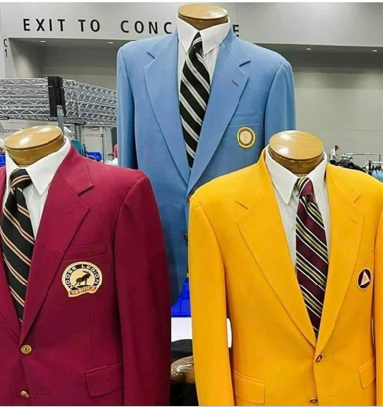
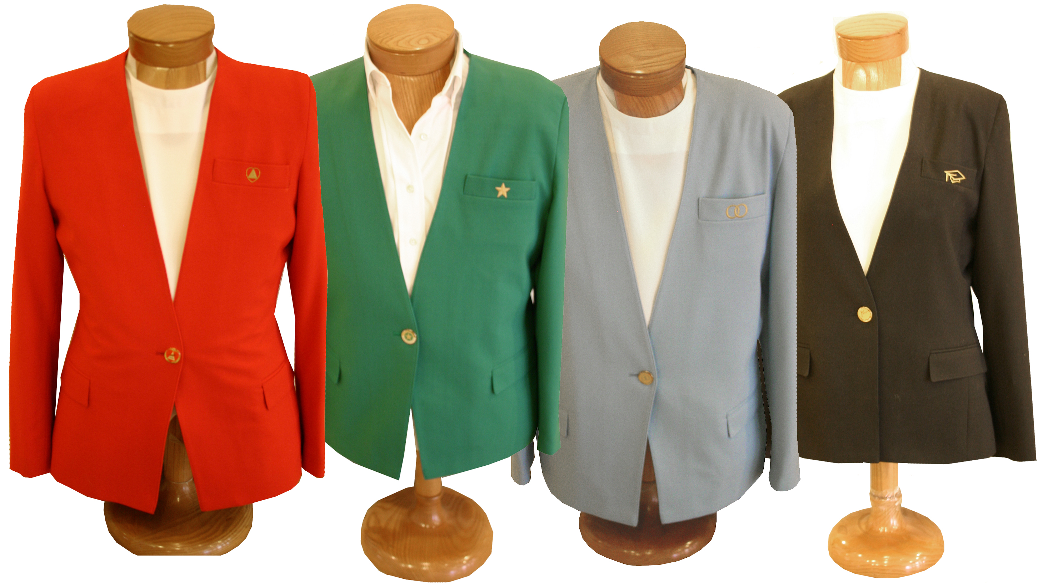
Similarities & Differences

Slide 15
Similarities
Differences
Must hold membership in auxiliary unit of The Moose
Consist of those members who “do more” for the fraternity
3 degree opportunities
No degree dues
Fulfills desire for gender specific fellowship and recognition
Earned vs. Honorary
Chapter membership is NOT a degree; Moose Legion membership is a degree
WOTM degrees are achieved within a fiscal year; ML degrees are awarded over a period of time
Can’t equate degrees
Females can’t earn honors based on Lodge participation or leadership
WOTM Call Cards are valid indefinitely

Slide 16
Next Steps for the
Fraternal Recognition Committee
Review and consider feedback that has been provided through the online survey launched in September 2023
Determine appropriate direction for future conversations
  Continue with degree programs in current state
  Develop a completely new member recognition program
  Construct a hybrid program (combination of current and new programs)
Schedule town hall meeting similar to One Moose for presentation to membership and subsequent discussion (date and location to be determined)

Slide 17

?
Degrees

Slide 18

COMPROMISES
CONSIDERATIONS
debates
OPINIONS

Slide 19
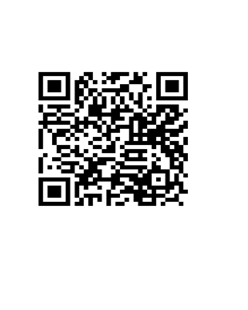
FRC@mooseintl.org
Scan now to access the latest member survey.
Your Comments Matter!

